Slide 1

Features and working of :

Slide 2
Main features of zoom :
1.HD video and audio
2. Participant camera feed
3. Audio-only conferencing
4. Cross-platform messaging
5. Password protection
6. End-to-end encryption

Slide 3
Exclusive Features :
Enable polling
Cloud recordings (paid)
File sharing
Zoom driving features for mobile devices
Multi-share

Slide 4
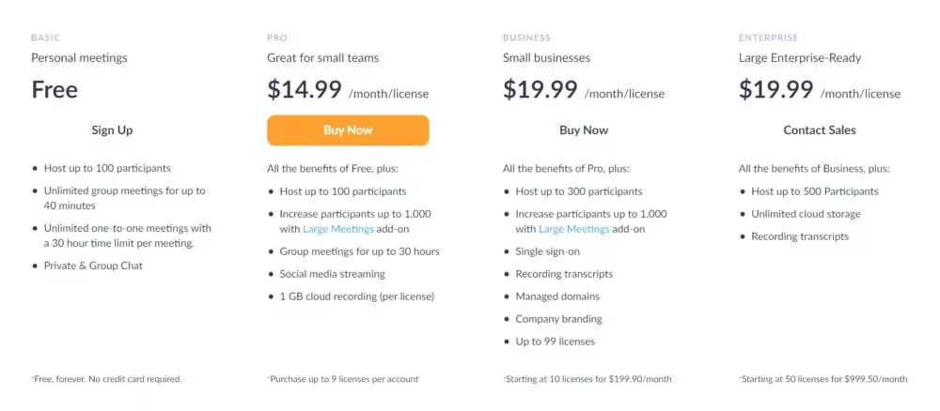
Working :

Slide 5
Thank you !

